Slide 1
POWER TRANSMISSION & SWITCHYARD

Slide 2
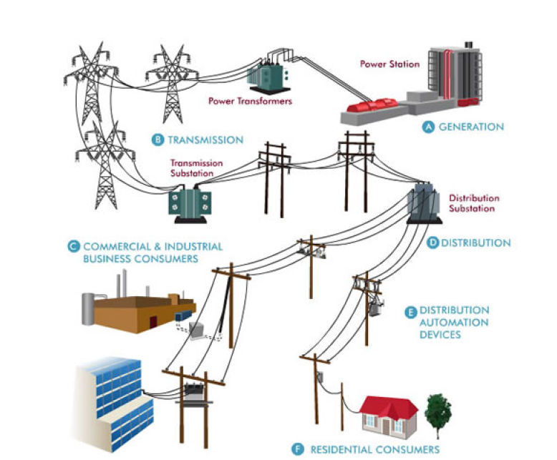
SAMPLE POWER TRANSMISSION DIAGRAM

Slide 3
Power Flow Diagram
NTPC-Korba
3 nos
Ranchi-2nos.
Raipur-2nos
Raipur-3
BILASPUR
ICT-2, 1000 MVA
765 KV Switch Yard
400 KV Switch Yard
ICT-1, 1000 MVA
IBT-1,2 &3
200MVA each
132 KV Switch Yard
Stage-II (2X500MW)
Stage-I (3x660MW)
5 Nos. Station Transformers
2Nos.MUW PH

Slide 4
HIGHLIGHTS
First switchyard charged at 765kV level.
Charged on 20th Jan 2007 by Hon MOP Shri. Sushil Kumar Shinde.
765kV Seoni line length – 357KM.(charged on 22nd Sep’07)
Power carrying capacity of each line – 2000MW.
ICT rating ( 765 / 400kV) – 1000 MVA
IBT(400/132 KV)-200 MVA
Number of breaks in a pole – FOUR.
Switchyard shield wire height – 46mtr.

Slide 5
SIPAT -765 KV SWITCHYARD
BILASPUR # 1
BILASPUR # 2
3X1 Phase,
80MVAR
3X1 Phase,
333MVA,
765/400KV
ICT # 2
BUS # IV
BUS SECTION # I I
BUS # II
ICT # 1
CB
CB
CS
CS
CB
CB
CB
CB
CB
CS
CS
CS
BUS SECTION # I
BUS # III
BUS # I
3X1 Phase,
80MVAR
UNIT # 5
(500MW)
UNIT # 4
(500MW)
UNIT # 3
(660MW)
UNIT # 2
(660MW)
UNIT # 1
(660MW)

Slide 6
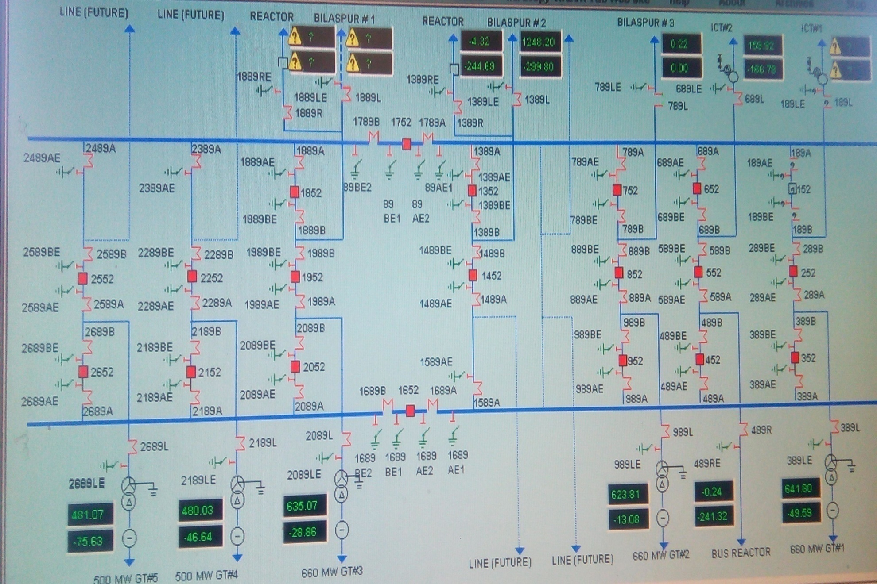
765kV SWITCHYARD SLD

Slide 7
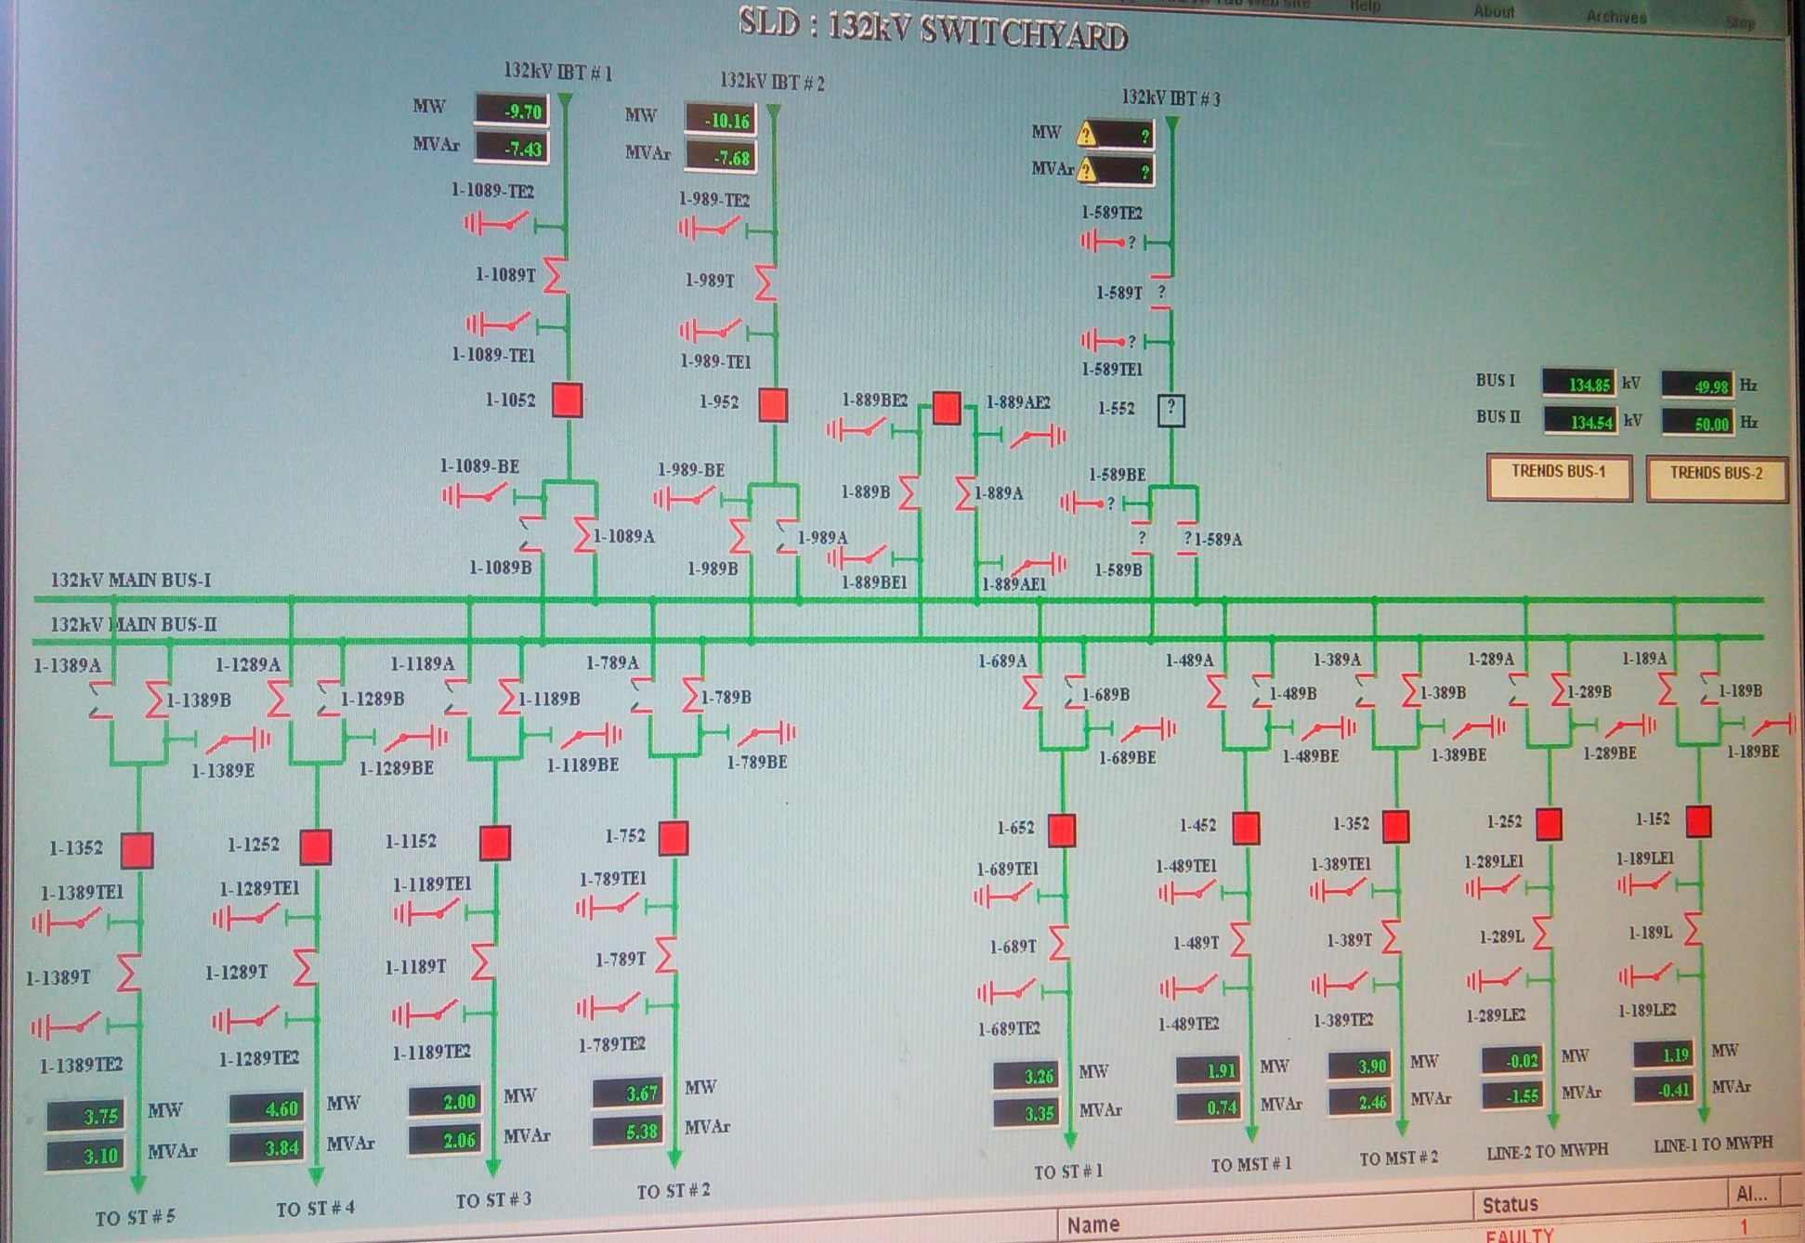
132kV SYSTEM(Single Breaker Scheme)

Slide 8
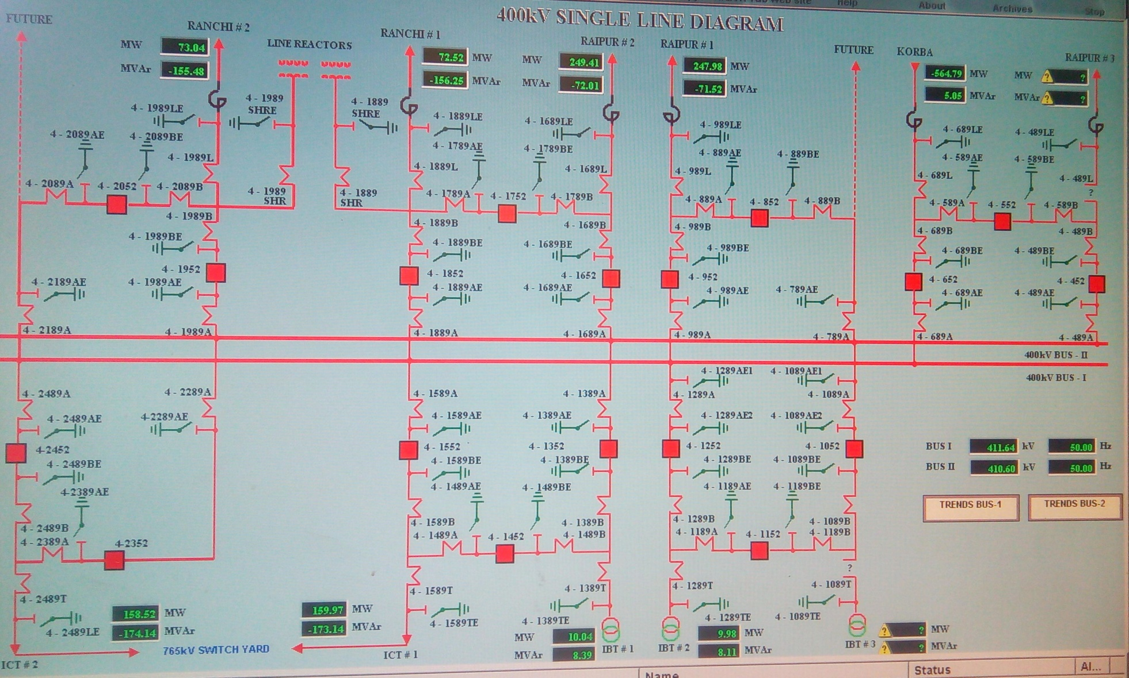
400kV SWITCHYARD SLD

Slide 9
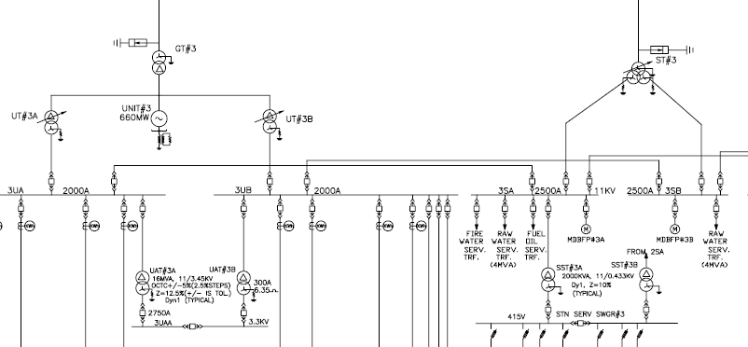
A CONSOLIDATE SINGLE LINE DIAGRAM FOR VARIOUS AC VOLTAGE LEVEL USED IN PLANT

Slide 10
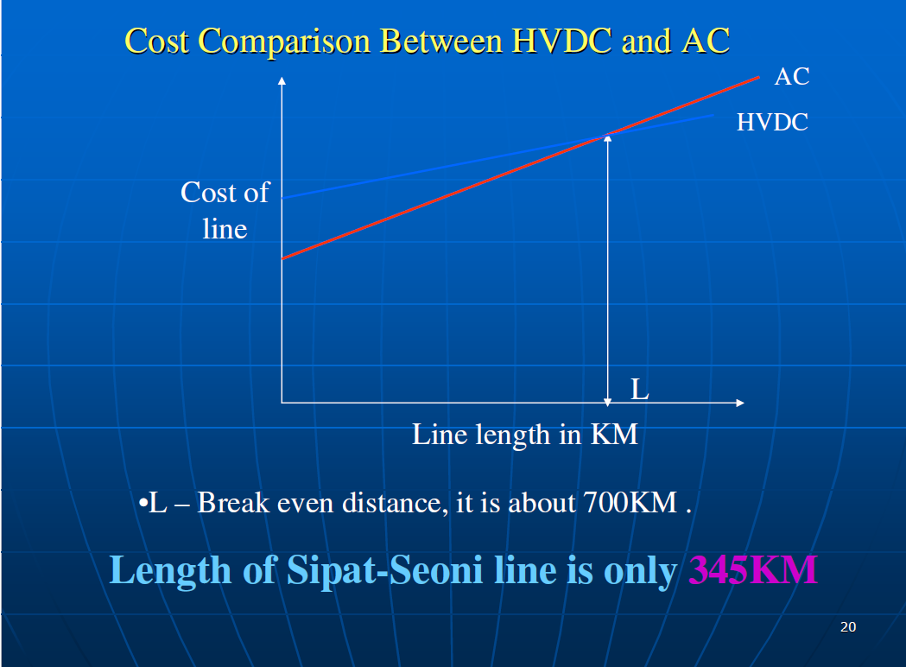
Why AC??
and not HVDC

Slide 11
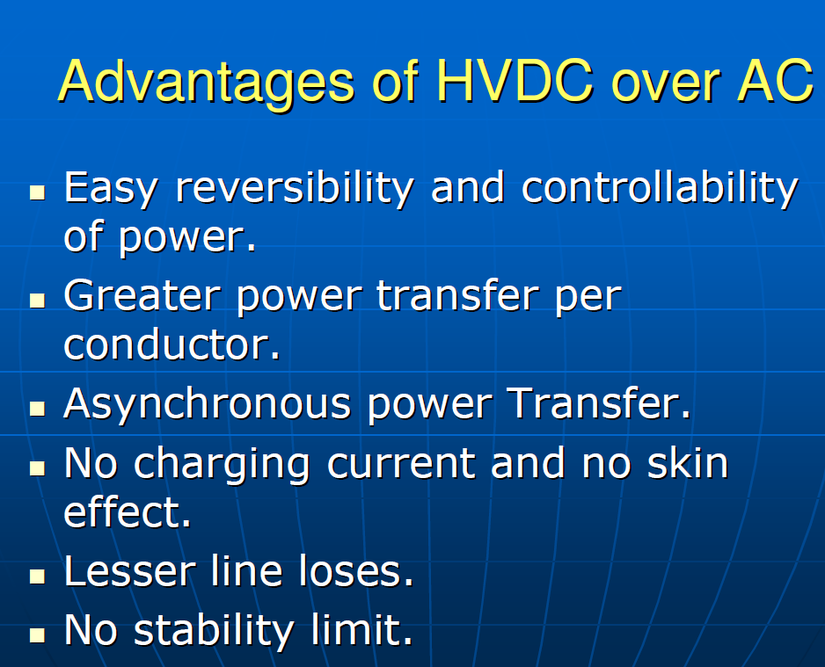

Slide 12
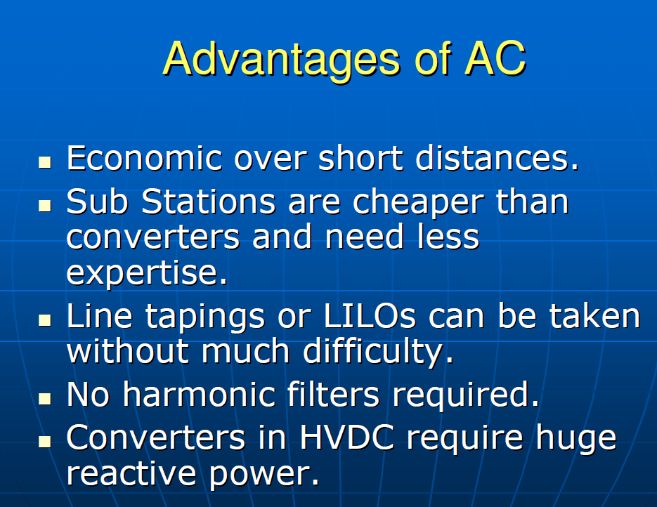

Slide 13
MAINTENANCE
Very High Elevations
Equipment 14mtr.
Bus 25mtr.
Jack bus 36mtr.
Shield wire 46mtr.
Very High Induction voltage.

Slide 14
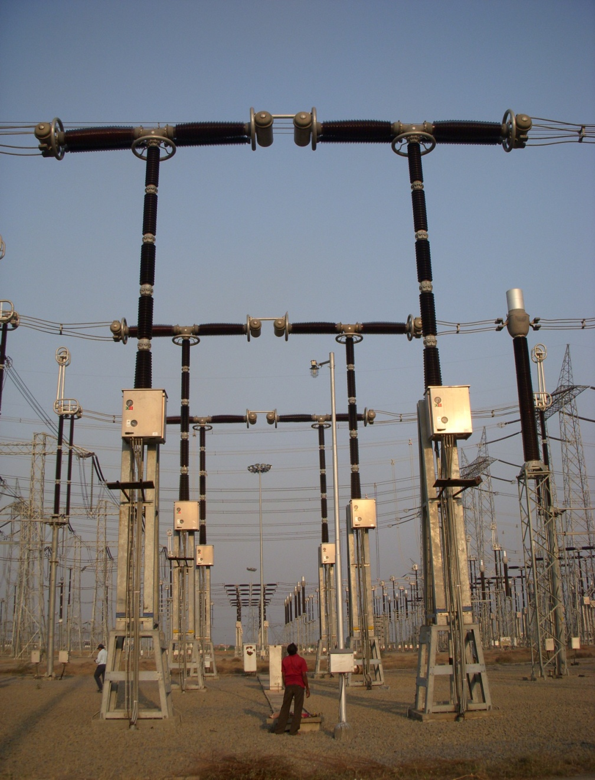
CIRCUIT BREAKER
Model – GL 318
Height – 15Mtr
Break – 4 per pole.
Dielectric medium – SF6
Operating mechanism – Spring

Slide 15
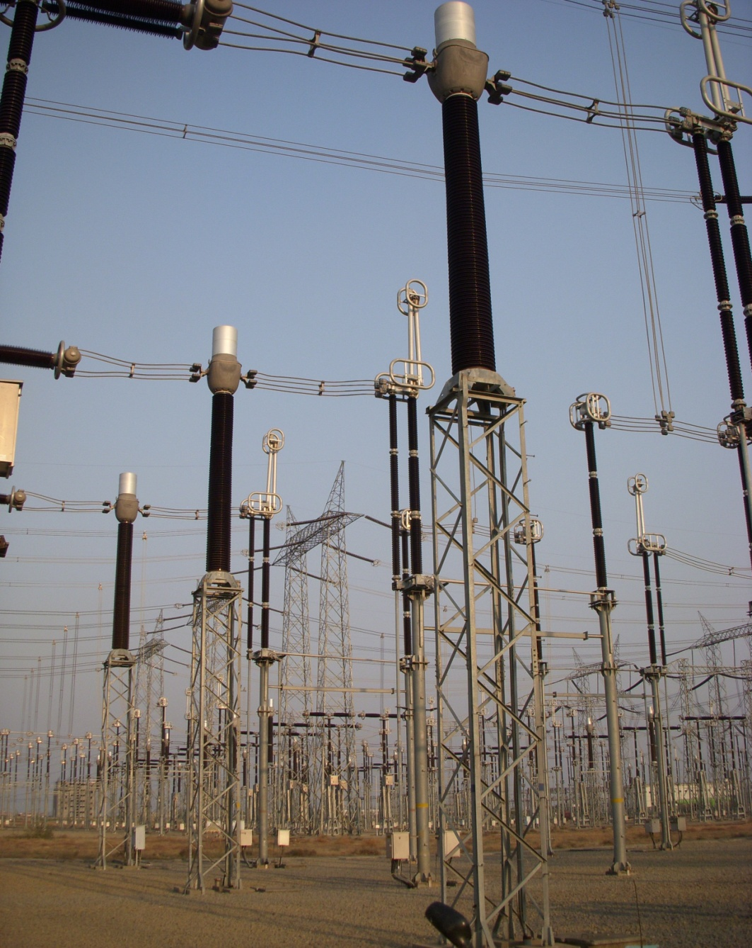
CURRENT TRANSFORMER
Model – CTH 765, Live tank
Height- 14 Mtr
Ratio – 3000-2000-1000-500/1

Slide 16
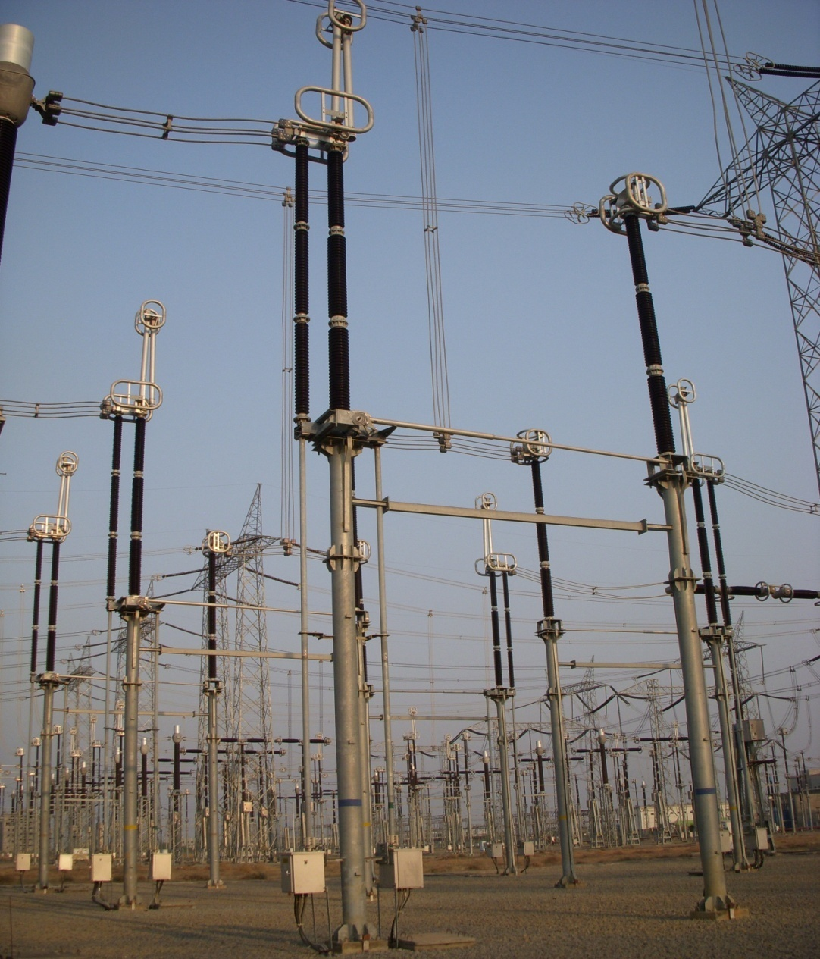
ISOLATORS
Model – SPOLT, Italy
Horizontal Semi-pantograph Type
Maintenance free

Slide 17

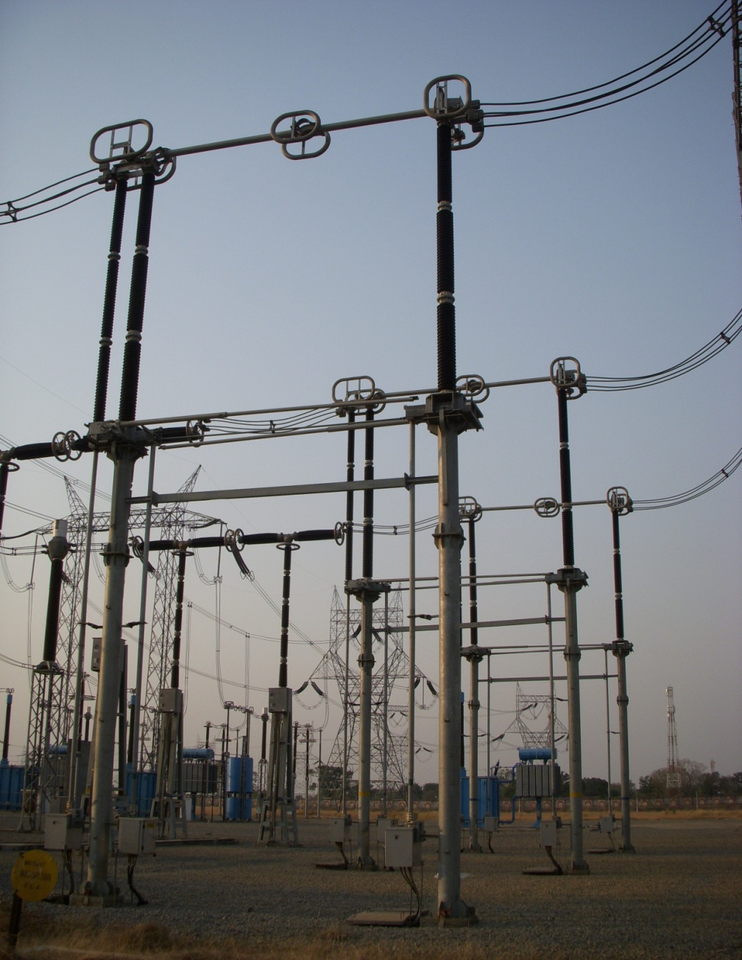

Slide 18
Wave Trap

Slide 19
Voltage Transformer

Slide 20
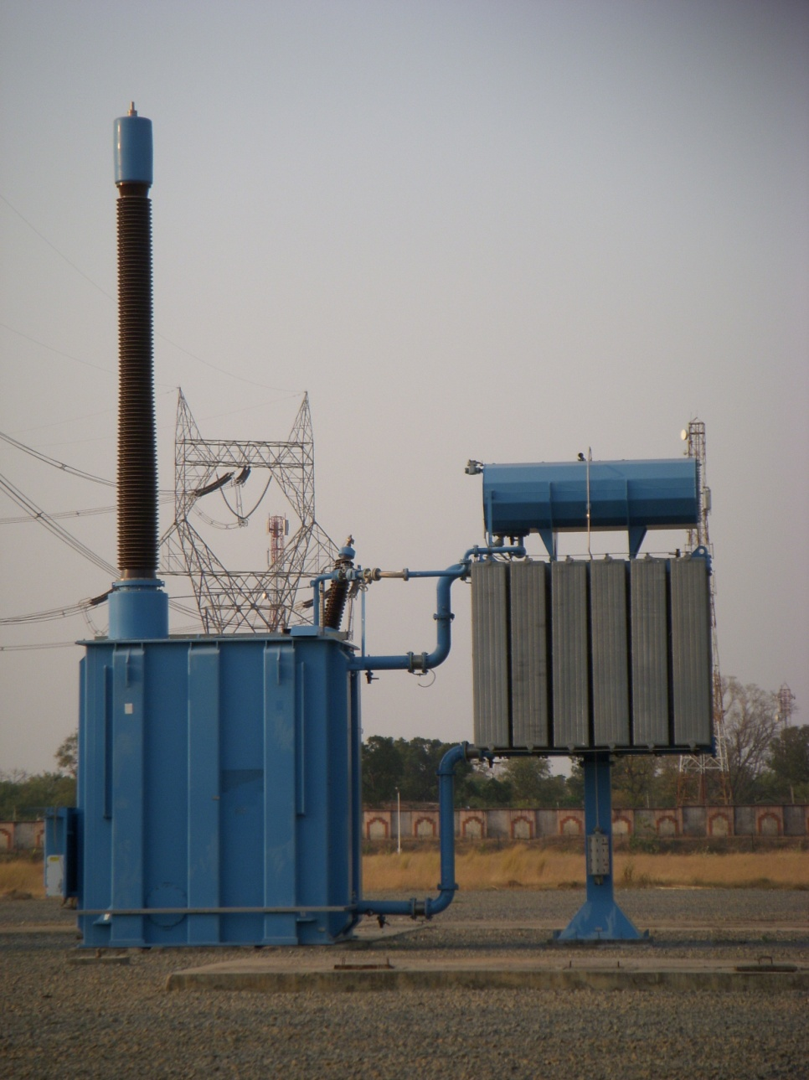
Transformers & Reactors

Slide 21
COMPARISON
 | 400kV | 765kV
Ground Clearance | 8 Mtrs | 14 Mtrs
Phase to phase | 7 Mtrs | 14 Mtrs
Main Bus Height | 8 Mtrs | 26 Mtrs
Equipment Height | 8 Mtrs | 15 Mtrs
Jack Bus Height | 16 Mtrs | 38 Mtrs
Shielding Wire Height | 24.5 Mtrs | 46 Mtrs
Highest System Voltage | 420 Kv RMS | 800 Kv RMS
Lightning impulse voltage | 1425 Kvp | 2100 Kvp
Switching Impulse voltage | 1050 Kvp | 1550 Kvp
Power frequency withstand for 1 min | 630 Kv RMS | 830 Kv RMS

Slide 22
CONVENTIONAL CONTROL AND PROTECTION PHILOSOPHY IN NTPC
CONTROL ROOM
CONTROL PANELS
CLOSE / OPEN
COMMANDS
HARD-WIRED FIELD INPUTS FOR
CONTROL AND PROTECTION
FUNCTIONS
BMK
BMK
PROTECTION
TRIP
COMMANDS
PROTECTION & RELAY PANELS
HARD-WIRED LOGIC IS FORMED IN BMK, CONTROL, RELAY AND PROTECTION PANELS FOR CONTROL AND PROTECTION TRIP FUNCTIONS

Slide 23
WHAT IS SUBSTATION AUTOMATION SYSTEM
Automation, in general, means use of intelligent electronic devices (IEDs) to optimize the management of capital assets and enhance operation and maintenance (O&M) efficiencies with minimal human intervention
In the context of switchyards, automation means use of IEDs for control, protection and other data acquisition functions

Slide 24
WHY SUBSTATION AUTOMATION SYSTEM
Rapid development and deployment of IEDs in substations like-
Protective relays
Energy metering systems
Equipment condition monitoring systems e.g. On line dissolved gas monitors, partial discharge monitors, battery monitors etc.

Slide 25
WHY SUBSTATION AUTOMATION SYSTEM
ISLANDS OF AUTOMATION WITHIN SUBSTATION
SUBSTATION
PROTECTION
SCADA
DFR/SOE
EQUIPMENT
DIAGNOSTICS
METERING
PROTECTION
METERING
OPERATIONS

Slide 26
THANK YOU

